Slide 1


Autotuning Parallel Application in Heterogeneous Systems
João Alberto Trigo de Bordalo Morais
Supervisor:
Jorge Manuel Gomes Barbosa

Slide 2
Agenda
Context
Autotuning to Achievethe Highest Processing Power
Problem
Possible Solution
Solution’s Approach
Impact
Solution’s Validation
Solution’s Methodology
Work plan

Slide 3




Context

Slide 4

Context

Slide 5

Context
CPU
GPU
XEON PHI
FPGA

Slide 6



Autotuning to Achive the Highest Processing Power
Using Computers’ Heterogeneous Components
Using Code Parallelization

Slide 7
Heterogeneous Components
Twin Peaks
CPU
Mapping Computation Kernels
Mapping Memory Spaces
Low-level Optimizations
GPU

Slide 8
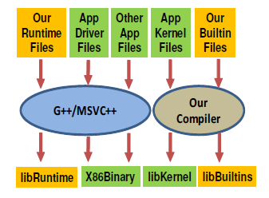
Heterogeneous Components
Notes:
Figure 5 showcases the overall framework to execute applications in Twin Peaks. The functions of the application that
need to be accelerated are re-written in OpenCL (App Kernel Files) and the code calling these functions is changed
to use the OpenCL API (App Driver Files). The rest of the application remains unchanged (Other App Files).
The kernel files are then compiled using our compiler to generate x86 libraries (libKernel), whereas the other application
files are compiled using native compilers (e.g., g++, MSVC++) to generate x86 binaries. Our runtime files are
also compiled using the native compilers to generate a runtime library (libRuntime).

Slide 9
Code Parallelization
Kremlin
Find possible paralized regions
Kismet
Parallel speedup estimation
Argo
autotuning framework to dynamically adapt applications in multicore architectures

Slide 10


Problem
Software Application
Heterogeneous System

Slide 11



Possible Solution
Original Source Code
Autotuner
Optimized Source code

Slide 12
Solution’s Aproach

Slide 13


Impact
Highest Performance
Less Energy Consumed
Developers’ Time Saved

Slide 14
Solution’s Validation

Slide 15
Solution’s Methodology

Slide 16
Work Plan

Slide 17


